Slide 1
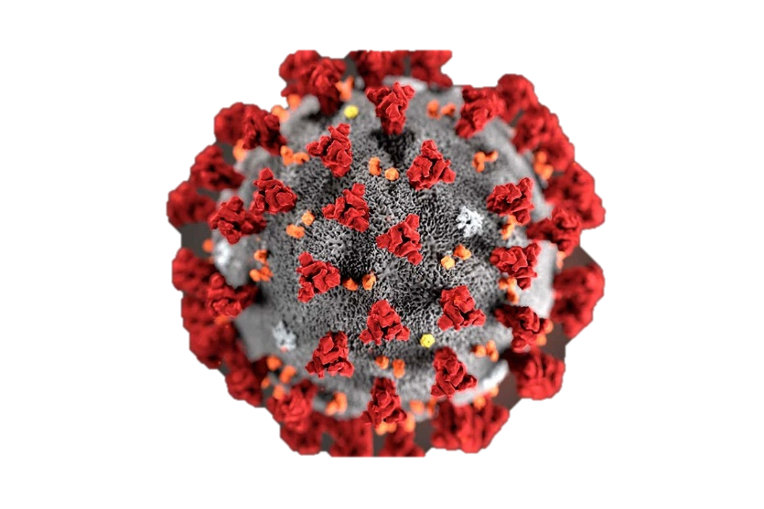

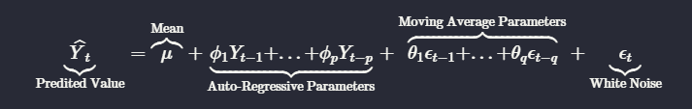
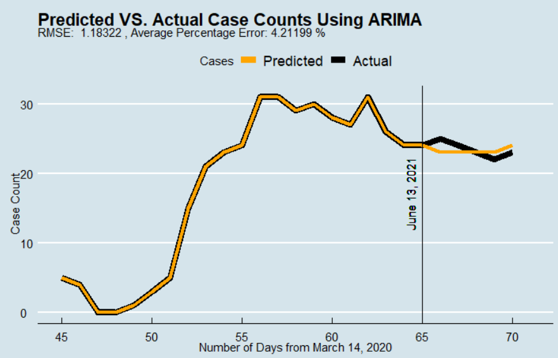
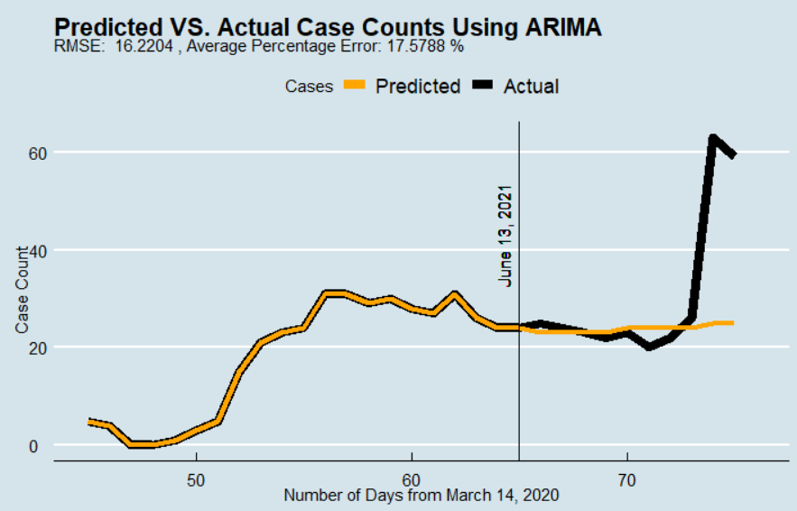
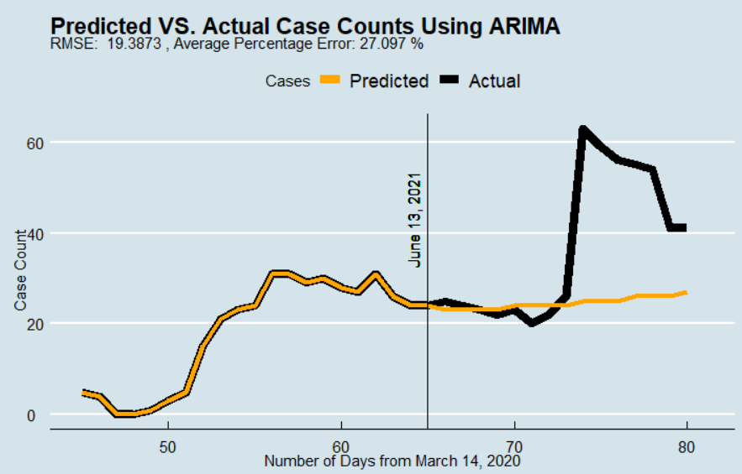
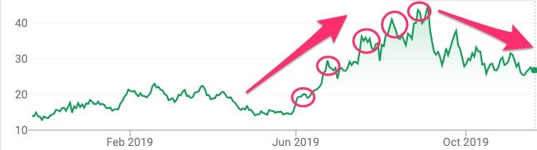
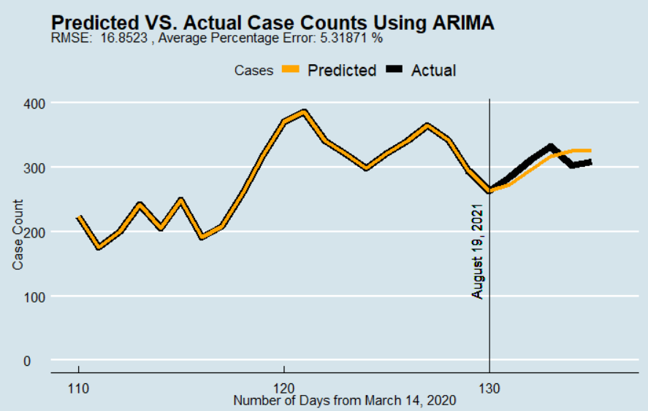
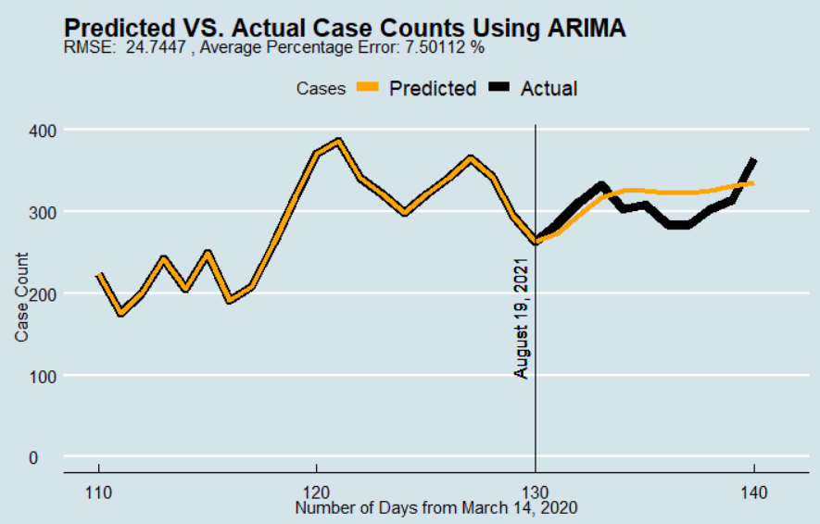
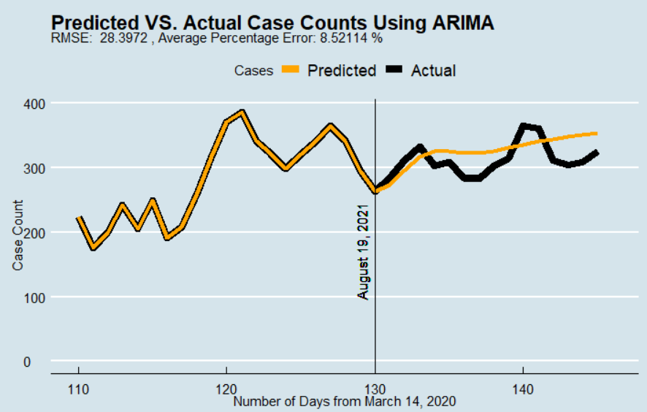
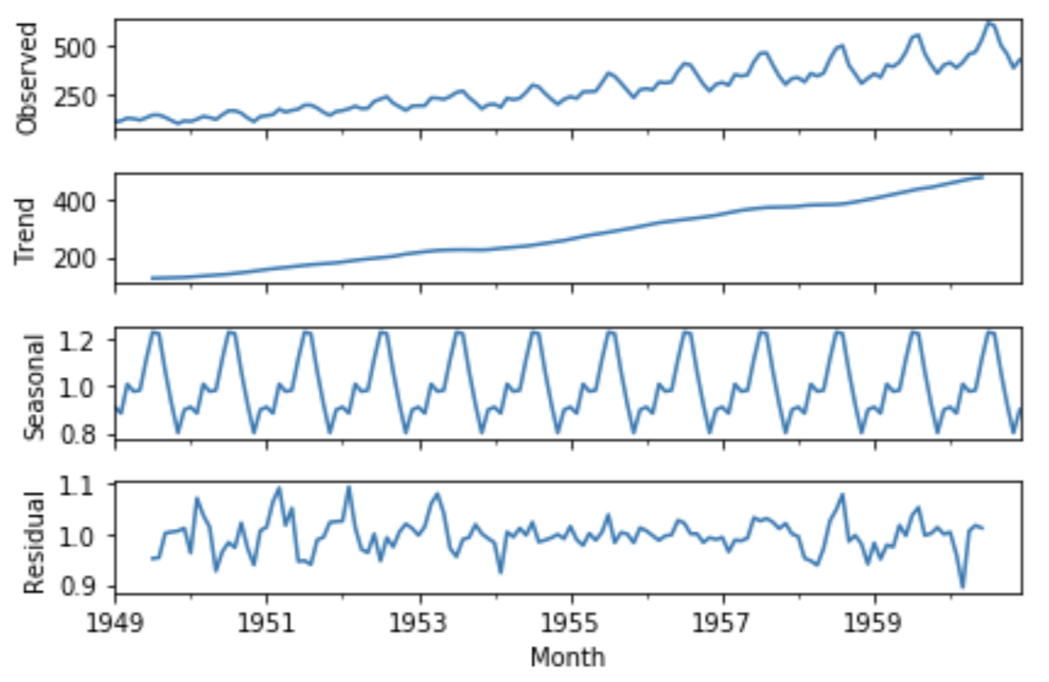
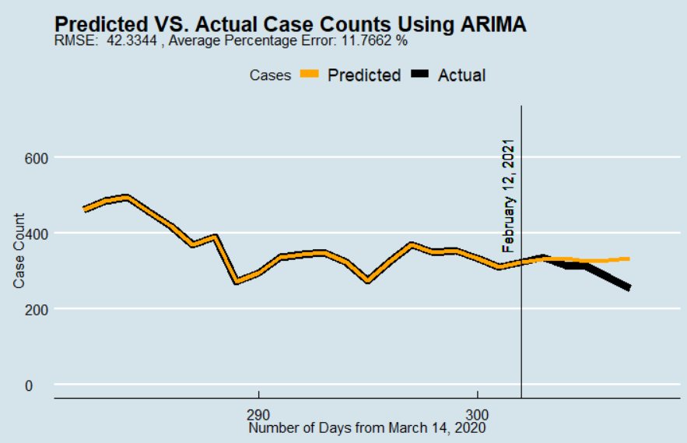
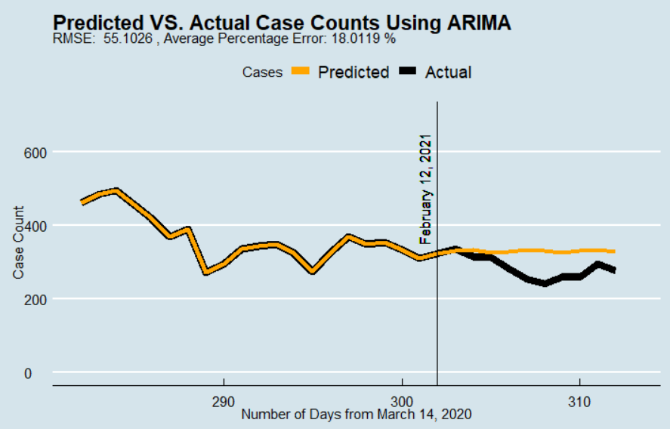
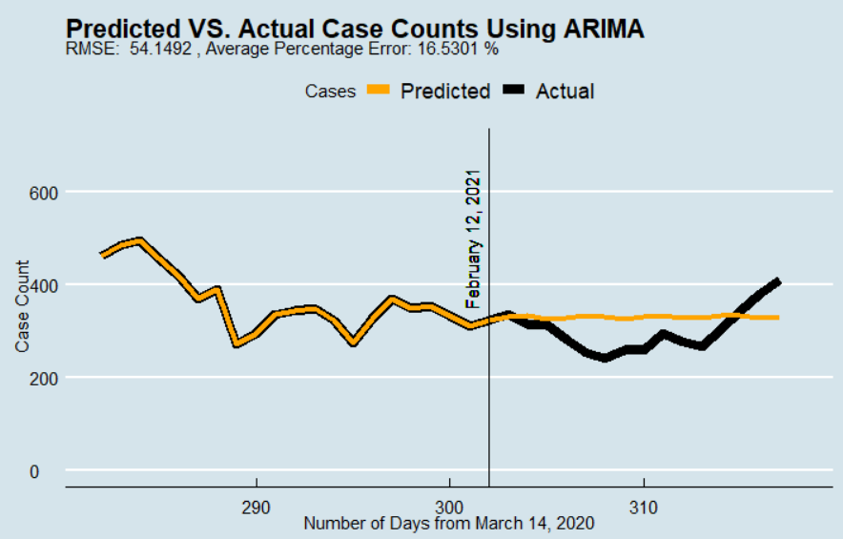

Time Series Analysis with COVID-19
Jackson Dial
Introduction/Abstract
Forecast/Validation
Conclusions
Given the recent outbreak of SARS-CoV-2, or more commonly known as COVID-19, it was of interest to utilize statistical modeling techniques to predict or forecast the number of active cases of the disease in the Eastern Idaho Public Health District.
It was hypothesized that the number of cases on a given day under EIPH supervision (or active cases) could be predicted based on the past number of cases that were observed. The selected method was to use ARIMA regression modeling, which mathematical model is given by the following, in general terms:
The time series analysis was run entirely within RStudio, using data provided by the Director of EIPH, Gary Rackow. ARIMA models are typically evaluated based on an AIC value, or a log-likelihood. These values are insightful, but I chose to use a different method, more of a validation of the model instead of an evaluation. To do this, I could only predict the number of cases on a given day that was already known. The timespan that was used is from March 14, 2020 (when the first case was reported in EIPH) through February 27, 2021 (when the data was last pulled from the EIPH database).
Below are plots showing the ARIMA prediction models and the accompanying error. This model used 65 days to ‘train’ the model, and then predicts the next 5, 10, and 15 days.
An ARIMA model has a lot of potential to forecast a given variable, but as anyone who has checked the weather knows, it is never guaranteed that your model will be correct or even accurate. I believe a weakness of ARIMA is that you can only use two variables; the one you are predicting and time. This is limiting in a way, because variables such as our case counts of COVID-19 are not likely to be singularly independent. The variable is probably correlated with another, which means if you can implement this into your model, it will have more predictive power.
There are of course means of accomplishing models that incorporate many different variables. One such model that I also explored is called a Recurrent Neural Network. This model is much more complex than an ARIMA model and understanding the mathematics behind RNNs is not necessarily fit for an undergraduate senior project. A particular area of interest with these kinds of RNNs is a parameter called ‘attention’. Though there is not yet specific implementation of this in common machine learning libraries, it is a hot-topic right now in the field of ML. It is essentially what parts of the data that the model will pay the most attention to. It is demonstrated by the plot below:
Though some of the ARIMA models do seem to fit the actual trends rather well, having less than 5% error for a 5-day prediction, there are many other factors to consider before we trust an ARIMA model to predict case counts of COVID-19. There are also exponential smoothing models, which have been shown to predict better than some ARIMA models in certain situations. Whatever method is chosen, it is important to validate your models on already known data. Though most of your models will output values such as the AIC or log-likelihood, these values are not as intuitive as a percentage error on known data, especially in most business and healthcare applications. The process of validating models on previously known data can be rather helpful, especially in parameter selection.
To build a model, you must first create a time series (ts) object from your data, which is in turn fed into one of various ARIMA functions:
Objectives
The goal of this project is to accurately predict the number of active cases in EIPH. It was of interest to use an approach similar to some machine learning algorithms, where a model is fit on only a portion of the entire data, then that model is used to predict the next few known, but unknown to the model, observations. This provides a more involved approach to the modeling process.
In the above code, there are 3 parameters that are used in the ARIMA model. To determine these, you begin by finding d, the differencing term. This is the number of differences needed to make the series stationary. A term with d=2 is computed by:
These plots show predictions for the same 5, 10, and 15 day periods, but use a bit more data, 130 days:
Once d is determined, the p and q terms can be determined by observing the ACF and PACF plots, respectively.
Time series is a rather complex field of forecasting, as can be observed by the plots below. These are the 4 major components of a time series, and each must be considered when building a model.
Conclusions
These plots use the entirety of the dataset while still being able to validate by using a 15-day forecast, 302 days:
Acknowledgements/References
Garrett Saunders, Ph.D.
https://www.itl.nist.gov/div898/handbook/pmc/section4/pmc442.htm
https://people.duke.edu/~rnau/411arim.htm
https://otexts.com/fpp2/arima.html
https://www.tensorflow.org/tutorials/structured_data/time_series#recurrent_neural_network

